Slide 1
CS5187: Vision & Image
Zhu Zhiyu
Tutorial 04: Classification and depth estimation
Notes:
How about now?

Slide 2
（1）Classification
What we will cover today:
Introduction to the CIFAR-10 dataset.
Building a custom Convolutional Neural Network (CNN) from scratch.
Adapting a state-of-the-art Vision Transformer (ViT) for a custom task.
Understanding the differences in data processing for CNNs vs. ViTs.
Writing a standard PyTorch training loop.
Notes:
First, we should talk about what an image is.

Slide 3
（1）Classification
What are we trying to classify?
The Dataset: 60,000 color images (50,000 for training, 10,000 for testing).
The Classes: 10 distinct categories (airplanes, cars, birds, cats, deer, dogs, frogs, horses, ships, trucks).
The Challenge: The images are incredibly small—only 32x32 pixels.
Why it matters: The low resolution forces our neural networks to learn highly efficient feature representations to tell a dog apart from a cat.
Notes:
First, we should talk about what an image is.

Slide 4
（1）Classification
CNN
How it works: Uses sliding windows (filters/kernels) to detect local patterns like edges, corners, and textures.
Architecture: Layers of Convolutions $\rightarrow$ Pooling (downsizing) $\rightarrow$ Fully Connected (Classification) Layers.
Why it fits CIFAR-10: CNNs are naturally suited for 32x32 images. They are computationally lightweight and train quickly from scratch on smaller datasets.
Notes:
First, we should talk about what an image is.

Slide 5
（1）Classification
The Modern State-of-the-Art
How it works: Inspired by Natural Language Processing. It treats an image like a sentence.
Patching: The image is chopped into a grid of smaller "patches" (usually 16x16 pixels).
Attention: Instead of local filters, ViTs use "Self-Attention" to look at the entire image at once and see how every patch relates to every other patch.
Notes:
First, we should talk about what an image is.

Slide 6
（1）Classification
Refer to the supplemented code
Notes:
First, we should talk about what an image is.

Slide 7
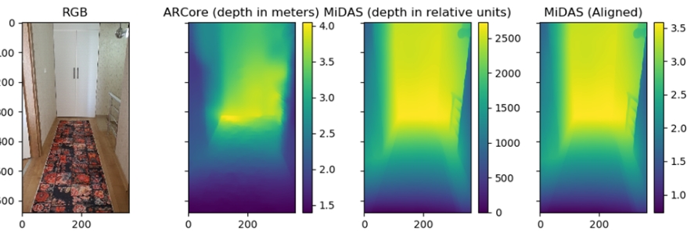

（2）Neural Network Depth Estimation
Notes:
First, we should talk about what an image is.

Slide 8
（2）Neural Network Depth Estimation
Refer to the supplemented code
Notes:
First, we should talk about what an image is.

